Slide 1
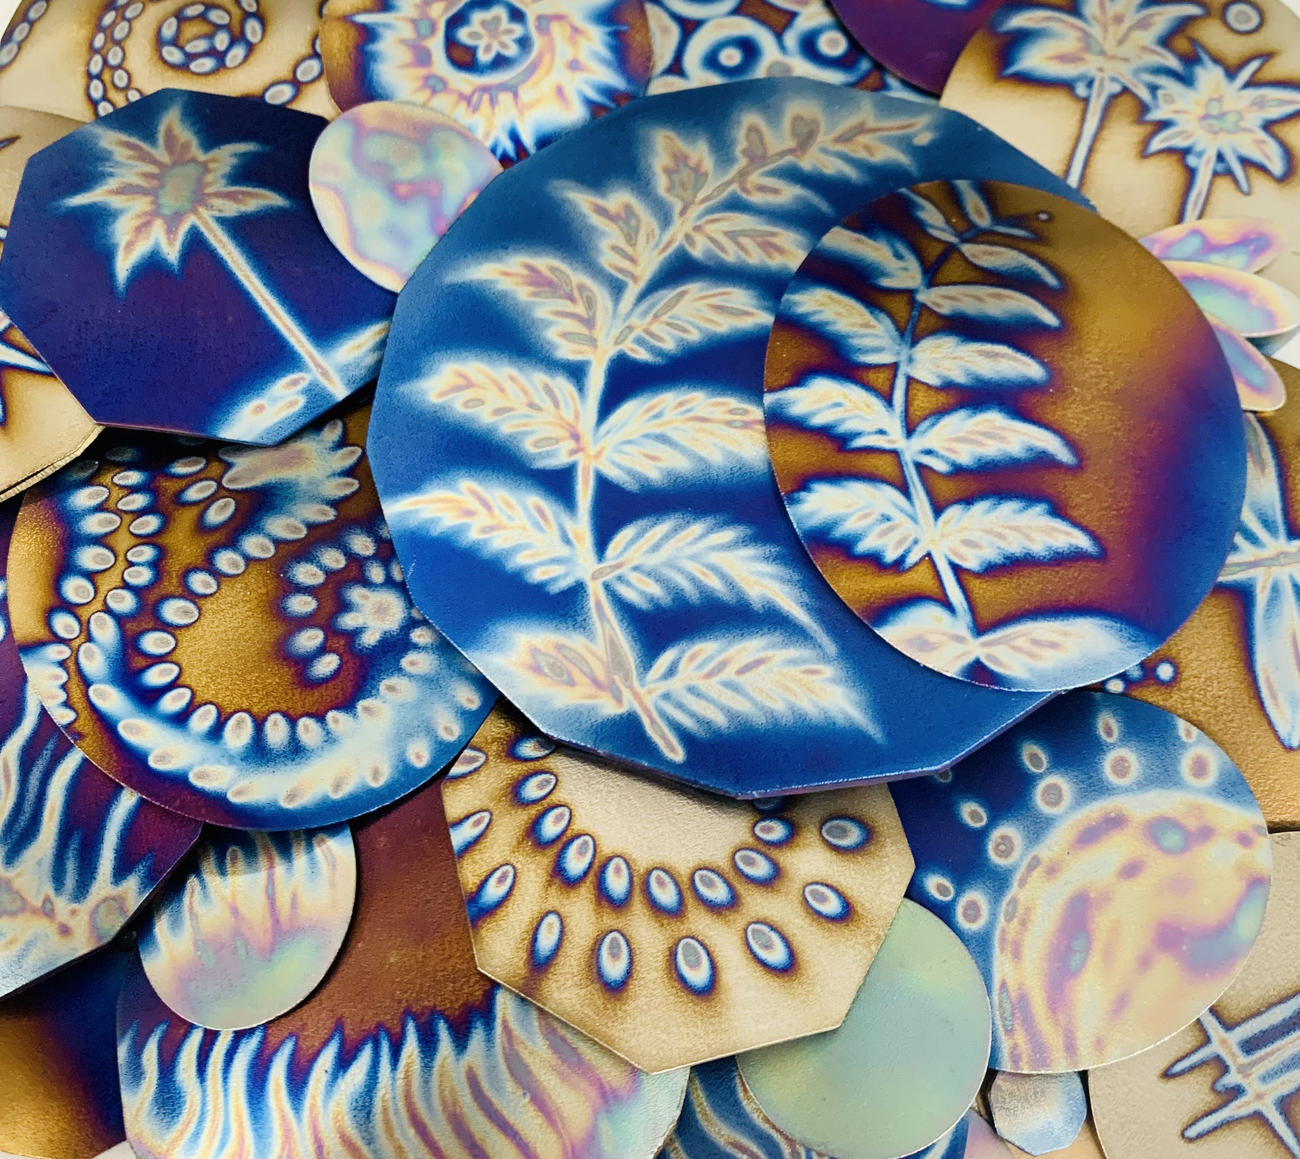
Welcome
&
Thank You for
Joining Me
for this Empowering Presentation!

Slide 2
Who is ZaKaiRan?
I am a Spiritual & Law of Attraction Teacher,
as well as Wellness Advocate.
I show people how to create the Happiness,
Well-Being & Abundance we all desire!
I have been trained in countless alternative healing systems,
including being professionally trained by Tesla’s how to dowse and harmonize Geopathic Stress Energies.
I have been a Tesla’s Consultant for over 20 years
and have countless extremely satisfied customers all over the world!

Slide 3
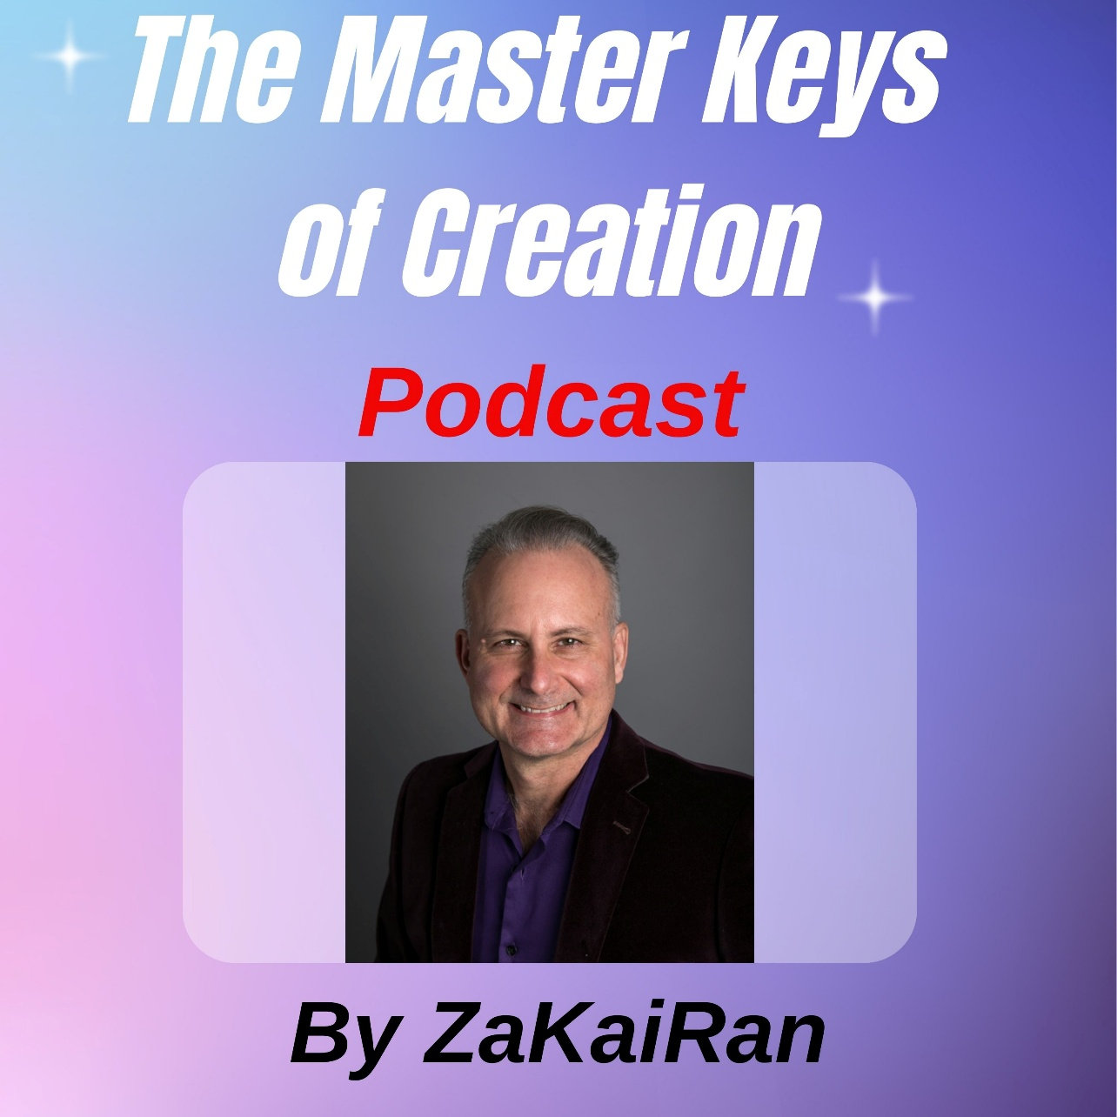
Who is ZaKaiRan?
-
You will find more self-empowering goodies to help you create the
Joy, Love, Well-Being, Abundance, Freedom and Fulfillment you desire… at my website
ZaKaiRan.com
and on
And my Master Keys of Creation YouTube Channel

Slide 4
Are you Concerned
about the
Damaging Effects
of 5G Microwave Frequencies?

Slide 5
And other
Electromagnetic Frequencies & Radiation… For your family’s
& your Health?

Slide 6
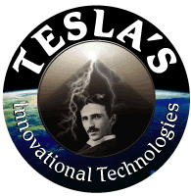
We Have the Solution!

Slide 7
Disclaimer
The information in this presentation is NOT intended
to take the place of professional or medical advice!
Please do not use this information to:
diagnose, treat, cure or prevent any disease for therapeutic purposes,
or as a substitute for the advice of a health professional.
We do not accept any liability for any injury, loss or damage
caused by the use of any of the information provided in this presentation.
The information in this presentation may include the views or recommendations of third parties and does not necessarily reflect the views of
Tesla's Innovational Technologies or Tesla’s Harmonizing Products!

Slide 8
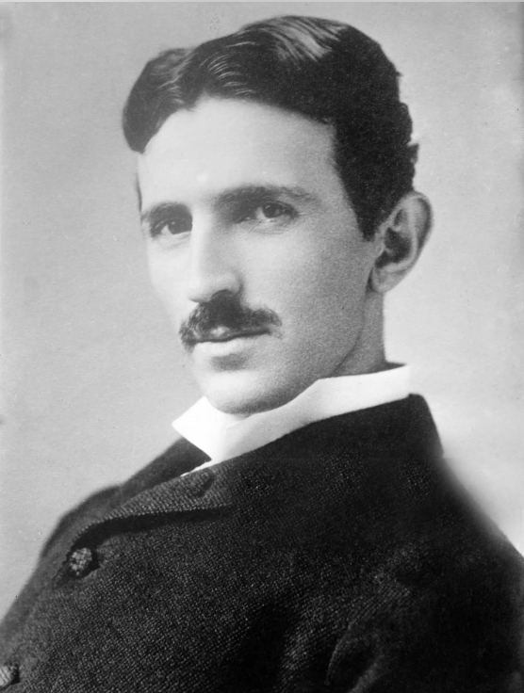
Who Are We?
We are not the car company!
Tesla's Innovational Technologies was formed in 1994,
named after one of the greatest inventors of all time, the great
Nicola Tesla

Slide 9


Tesla’s Mission
To Assist
the Planet’s Return
to Harmony & Balance Through
Ethical Technologies

Slide 10
Nikola Tesla
The Man Who Invented the 20th Century
Owner of 1600 patents!
27 honorary degrees
from universities
all over the world
(1870 to 1925)

Slide 11

Nikola Tesla is regarded as
the man who invented the 20th century
because of his role in the creation of modern 50 Cycles per second
Alternating Current Electricity with George Westinghouse.
You can watch countless documentaries and feature films about his inventions,
especially the electricity war between him and Thomas Edison.
Tesla was born in the town of Smiljan, in what was then the Austro-Hungarian Empire, now known as Croatia, who emigrated to the USA as a young adult,
and who invented the technologies that Tesla's Innovational Technologies produces.
He is the only person to have successfully registered sequential patents with the patents office!
That's how prolific of a genius inventor he was!

Slide 12
Nikola Tesla
His inventions include:
the hydroelectric generator,
microwave, x-ray, radar, radio,
remote control, fluorescent lights,
broadcast power, the rotary engine, the tesla coil
& countless other inventions.

Slide 13

Tesla was originally employed by Thomas Edison who was pushing Direct Current.
But Tesla disagreed and thought Alternating current was more feasible.
He eventually left the Edison company and created his own company
with George Westinghouse.
And in 1893, the Tesla/Westinghouse Alternating Current
was chosen over Edison's Direct Current to illuminate the World Fair in Chicago,
because it was half the price to generate and transmit electricity using AC technology, and needed far less infrastructure.
Nicola Tesla

Slide 14
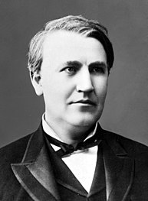

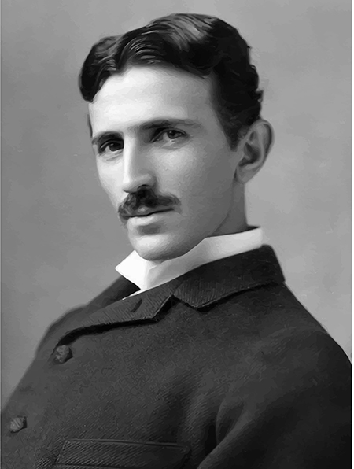
Nikola Tesla
The War of the Currents
50 cycles per second alternating current
Thomas Edison vs George Westinghouse & Nikola Tesla

Slide 15
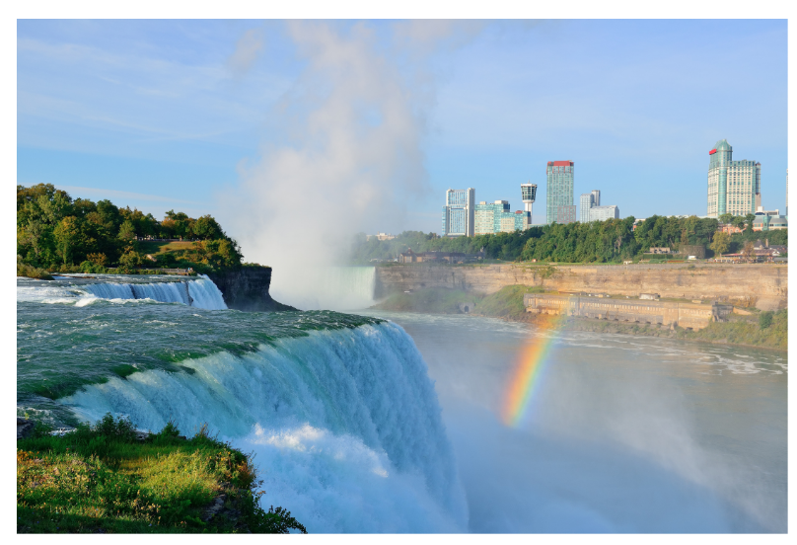
Niagra Falls Power Station
first
hydroelectric
power station
in the
World!

Slide 16
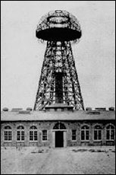
Wardenclyffe Tower, which Nikola Tesla built to transmit
FREE energy in 1901.

Slide 17

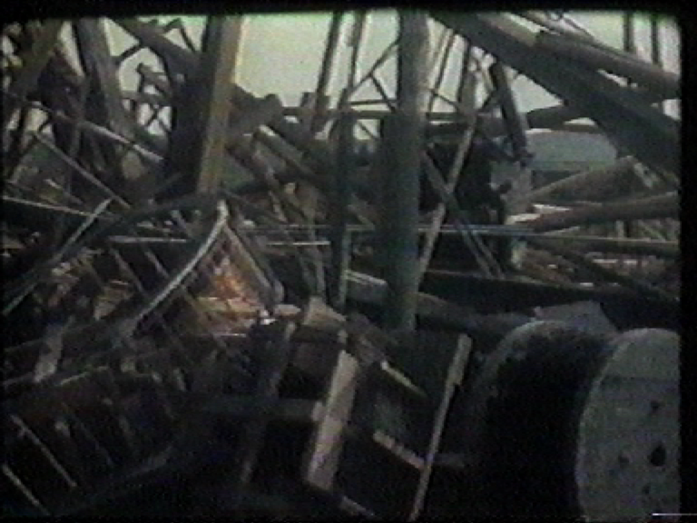
When Tesla realized that electricity was going to be damaging to our bodies,
he started thinking of less harmful ways to generate electricity.
And to generate it freely with no cost to anyone!
He built the Wardencliffe Tower to demonstrate his idea.
And conducted other experiments showing that light bulbs could be let with no wires.
His Tower was destroyed by the government under the guise that it could be sending signals to the Nazi's. Of course, this was a ruse, to destroy free energy.
Nicola Tesla

Slide 18
Geopathic Stress
Geopathy is the scientific theory
that links the earth’s inherent radiation
with the health of humans, plants and animals
Geo = Earth Pathic = Disease
Ley Lines, Underground Water,
Hartman lines, Raydon, Energy Vortexes…

Slide 19
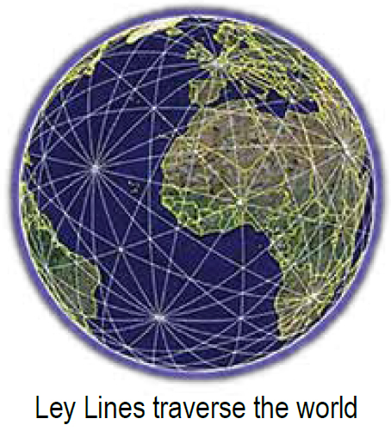
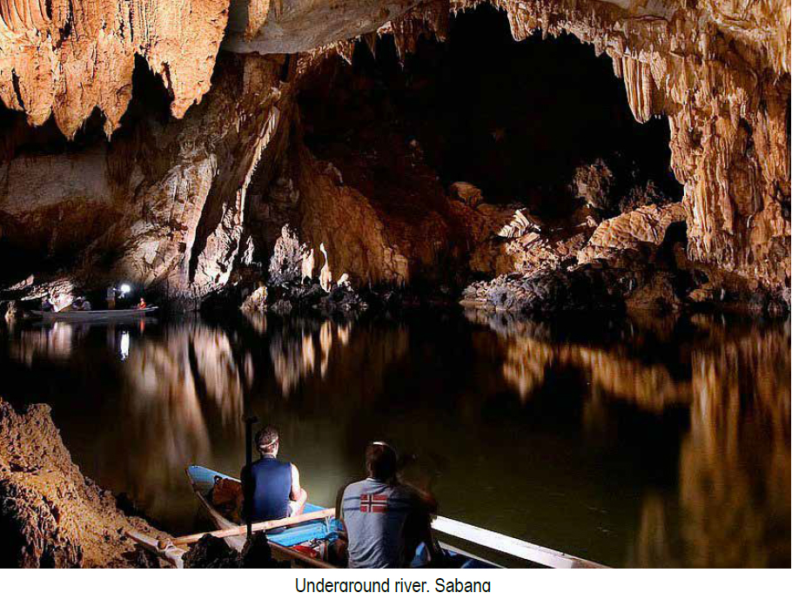
Natural Forms of Underground Geopathic Stress
Leylines Underground Water

Slide 20
Understanding Geopathic Stress & Health
Amongst European studies, doctors who between them have investigated over 10,000 cancer patients, found 92% were living in a GEOPATHICALLY stressed environment.
Geopathic Stress does not CAUSE any illness but lowers your immune system & your ability to fight off viruses & bacteria.
It is a weak, but continuous stress on the DNA.
Over a period of years, it seriously disrupts metabolism on a molecular scale.
The most common indication of Geopathic Stress
is resistance to treatment (either conventional or alternative).
GEOPATHIC STRESS can be any of three things:
1. Underground water
2. Above ground high-tension wires, phone towers etc.
3. Ley lines

Slide 21
Ley Lines
Ley-lines or “Light” lines, are cosmic energy lines originating inside the Earth that emanate out vertically from a point several hundred feet below the surface of the Earth. Ley-lines are part of the Earth’s energy system.
They travel in perfectly straight lines (seen from a ‘birds-eye view’), always maintaining the same depth relative to the surface of the Earth & crisscrossing each other over the whole planet, sort of like the longitude and latitude grid, similar to the human body’s energy meridians.
Ancient civilizations, such as the Druids, were aware of these energy lines, and those with vision, could see them. And they built their temples upon them, especially at the intersections of Ley Lines.

Slide 22
Ley Lines
Roman soldiers would march on these lines because they were so energizing. But people of those time also knew that because they are so energizing, that it is not recommended to live on a Ley Line because it is hard to relax and sleep, and can ultimately affect your health.
They didn’t sleep on them though,
as the body cannot relax properly on a leyline.
Scientists have proven that migratory birds have a protein in their eyes so that they can see these Ley Lines,
so they know where to fly for the winter.
Now people ignorantly build houses and live over
these potentially damaging energy lines.

Slide 23
Ley Lines
The widths of the lines vary.
The larger ones are 1.75 meters or 5.5 feet) wide
(the width of the Roman roads).
And are approximately 5¾ klm (3 miles) apart.
The smaller “Hartman lines” named after Dr. Ernst Hartman, who pioneered the field of Geobiology (the study of how the earth affects your health), in Germany, run north to south & are 7.5 cm or 8” wide & about 1.75 meters or 6 feet apart. There are also “Curry lines” which run northeast to southwest & are narrower, carrying a lot less energy than the Hartman lines.
Dr. Hartmann has over 40 years of extensive medical documentation to back up his claims about Hartman lines, other ley lines and their negative effects.
And has published three highly technical books
on the study of Geopathic Stress.

Slide 24
Ley Lines
Similarly, there are Earth vortexes (energy coming from the Earth in a spiral), which could be described as the earth’s chakra system, except the energy from vortexes spirals outward, rather than inwards like our chakras.
Ley-lines and vortexes will contribute to health issues especially if people sleep over them.
Especially dangerous is sleeping where leylines cross, and if a ley line crosses decaying matter, radiation, or a polluted river and picks up these negative energies.
Symptoms may include tension, anxiety, neurosis, hyperactivity or worse!
In northern Queensland
a young couple slept over a vortex during their pregnancy.
Their baby was born with the umbilical cord rapped around his neck 7 times.

Slide 25
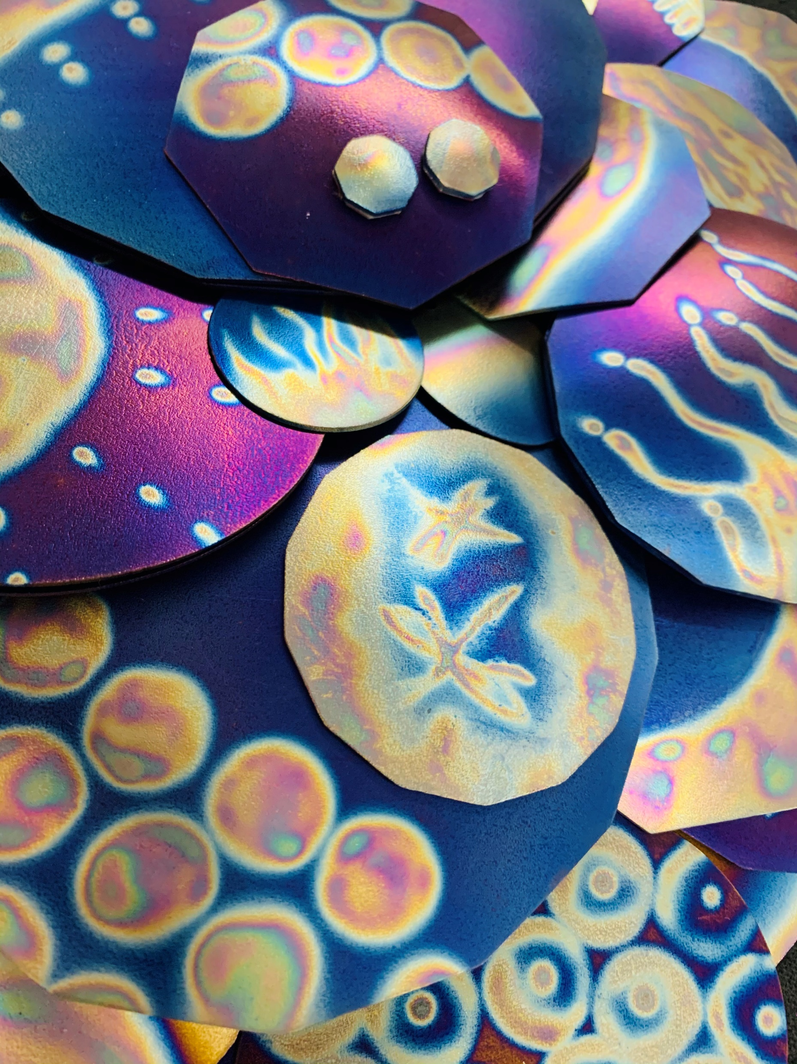
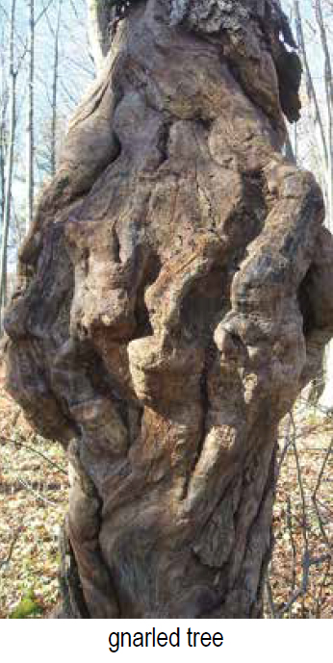
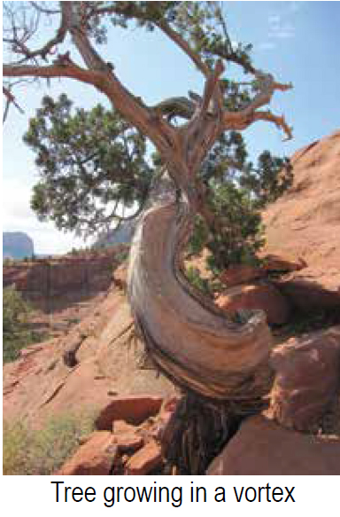
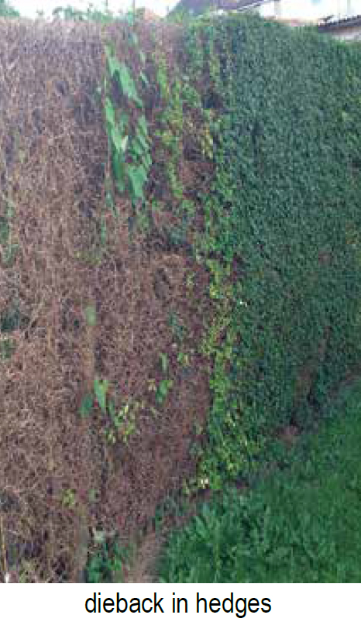

Slide 26
Ley Lines
In 1929, German Central Committee for Cancer Research in Berlin checked hospital records. It was found that all 54 patients, who had died of cancer since records had been kept, had slept in beds above Hartman Ley-line intersections.
In the 1970’s, Kathe Bachler, an Austrian schoolteacher, started one of the most extensive & recent research projects. She dowsed 3,000 apartments in 14 countries & interviewed 11,000 people.
Her conclusions were that 95% of the children with ADD or other health problems that she had investigated slept in beds or worked at desks placed at crossed Ley-lines. She also checked a sample of 500 cancer cases; every one was found to be sleeping over crossed Ley-lines.

Slide 27
Underground Water

Slide 28
Underground water
Underground waterways contain salts & minerals
that are perfect carriers of electricity.
As underground water flows, it carries EMFs, which rise vertically above the
water, even through multiple floors.
This vertical field of EM energy affects people physically, mentally & spiritually.
Sleeping over underground water
is similar to sleeping under high-tension electrical transmission lines.
Symptoms include:
"Heavy in my arms."
" Electrical fuzzy feeling."
"A directional pull, flowing like ripples."

Slide 29
Above Ground Geopathic Stress!
We now have a new form
of Geopathic Stress,
caused by Electricity
& related
Electromagnetic Technologies!

Slide 30
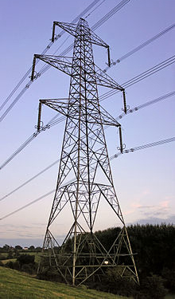
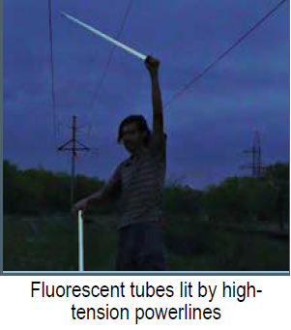
High Tension Power lines

Slide 31
High-tension Power-lines
Strong EMFs exist under high-tension power-lines!
These electrical cables often carry 400,000 volts or more.
When you stand under these lines you will often hear the hum.
In damp weather you can hear crackling as some of the electricity discharges into the atmosphere because powerlines ‘shed’ electricity, as the electricity travels along them.
Electrical companies estimate up to 20% wastage.
You can stand under the more powerful high-tension power-lines
& light up a fluorescent tube (as long as you don’t have a Tesla's Pendant on).
Common complaints:
* Perpetually lacking in energy,
* Nauseous or dizzy
* Asthma,
* Perpetually feeling stressed.

Slide 32
LIVING BENEATH POWER LINES
The most famous example of illness caused by high-tension power lines
is the English village of “Fishpond”.
High-tension power lines effectively surround this village.
Here many residents suffered similar symptoms over a long period,
but no clear connection to the villagers' health was made until the power voltages were increased and the incidence & severity of symptoms increased dramatically!

Slide 33
Step-Down Transformers & Cancer
In 1979 an American researcher Nancy Wertheimer, during her research into childhood Leukemia, first identified the possibility of a link between power-line transformers & cancer. Her data led her to the conclusion that children living in houses either side of electrical poles with step down transformers showed the highest incidence of the disease. Another researcher, Ed Leeper, did further detailed analysis of the results including, epidemiological studies, and his results supported the previous study. Studies done by Robert O Becker MD, U.S.A. & Dr Tomenius in Sweden, have supported Wertheimer's findings.
Unfortunately, the majority of the medical profession & the electric power supply companies have refused to admit that EMFs could produce carcinogenic conditions & have rejected the research.
There have been 2 court cases in America & Australia, leading to very expensive re-routing of power lines that were built near schools & residential housing!

Slide 34
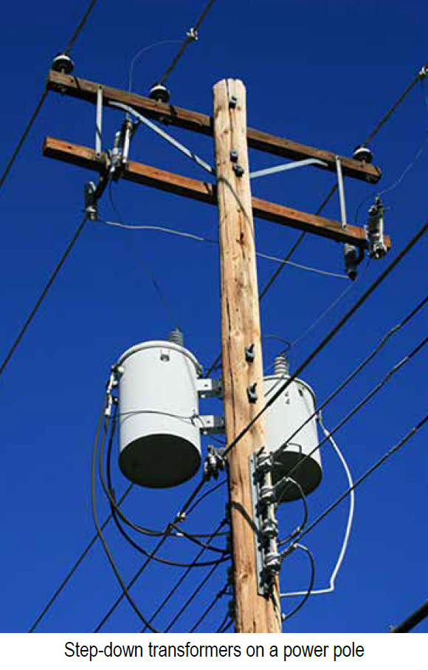
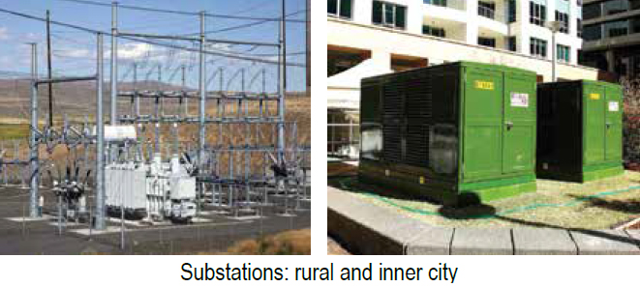
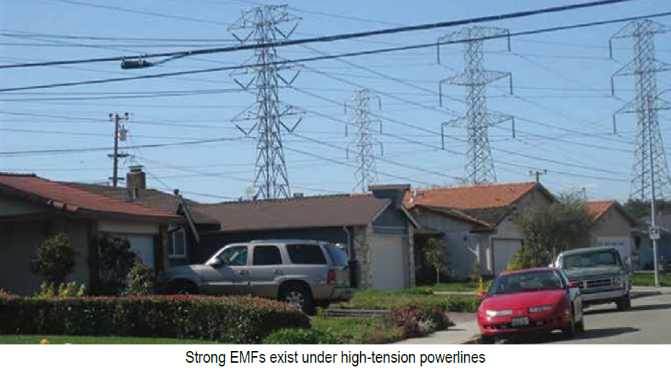

Slide 35
Radio Towers
In the 1950s one of the first commercial radio transmitters was placed on the roof of the Empire State Building, New York. The maintenance crew in charge of the installation discovered one of the properties of strong radio transmissions is cooking. If they put a sausage on a stick & placed it in front of a transmitter dish it would cook.
(This is one of the principles behind microwave ovens; working with high frequency oscillations causes the water molecules in the food to vibrate rapidly the resulting friction causing heat).
Unfortunately, the maintenance crew used the heating effect to warm themselves on cold nights by standing in front of the dishes. It all turned sour when years later, most of the crew developed a variety of cancers. Now it’s recognised that exposure to radio or microwave radiation is potentially very dangerous.

Slide 36
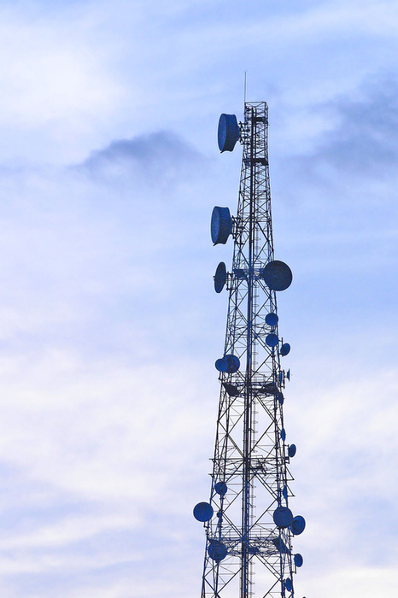
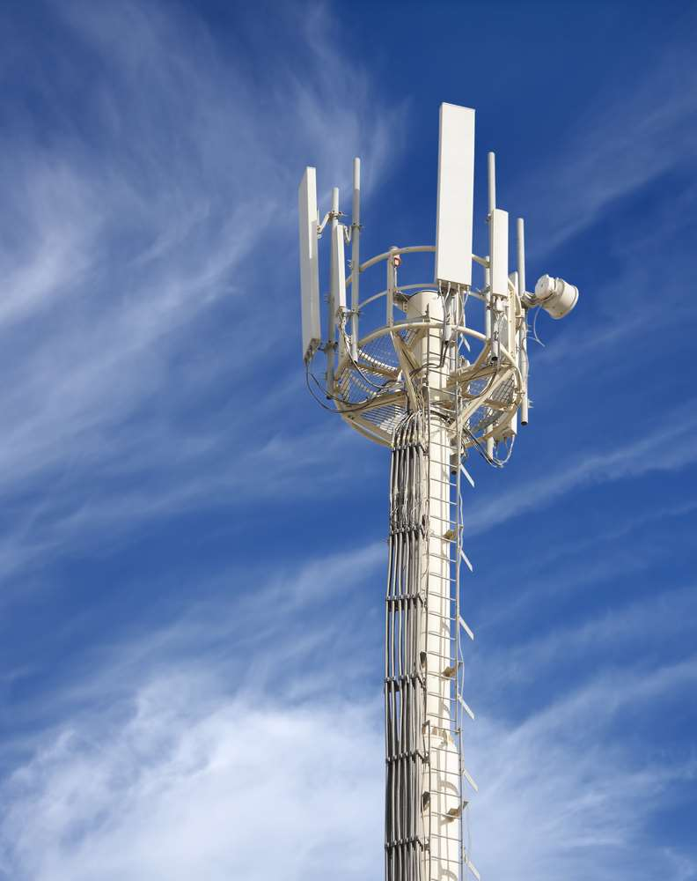
Phone Towers

Slide 37
Mobile Phone Towers
Sydney Suburbs
Dr Bruce Hocking (medical adviser for Telstra) conducted a health study in a 4km zone in a Sydney suburb surrounded by 3 mobile phone towers & 2 TV transmission towers.
Dr. Hocking’s findings showed children living within a 4 km radius of these had a 60% higher incidence of Leukaemia than children who lived further from the towers; also there was a far greater risk of dying from the disease.
Dr. Hocking also found a slightly increased rate of adult cancer in the study area than beyond it. Dr. Hocking lost his position over these findings.

Slide 38
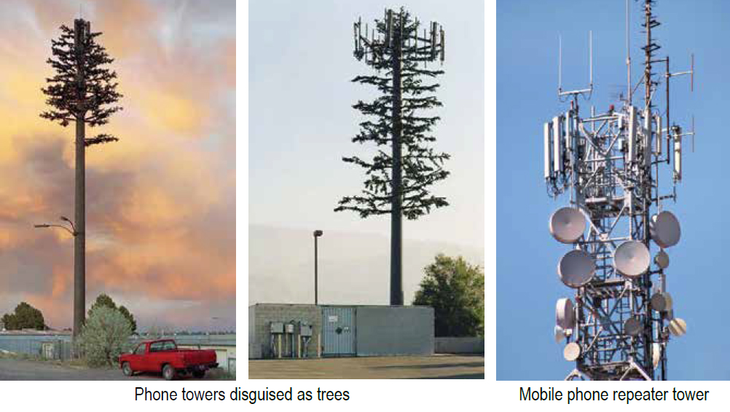

Slide 39
Mobile Phone Towers
An English School
In September 2004 the attention of the Royal Society of Medicine, London, was directed to a primary school on the south coast of England. During June 2004, 11 children in various classrooms suddenly & simultaneously developed nosebleeds & nausea for no apparent reason.
It was 2 weeks before the school discovered a mobile-phone tower that had been erected 4 weeks earlier (750 mtr away), had been switched on that particular morning! It was evident the radiation being transmitted had caused the physical reaction in the children.

Slide 40
Mobile Phone Towers
Professor Stephan Gift, of University of the West Indies (UWI) Faculty of Engineering, is quoted based on his research, “Radiation caused alteration in brain waves, a two-fold increase in child leukemia & changes in the human immune system.”
He also sourced information from a “Reflex Study” done by 12 groups in seven European countries who’s findings showed that radiation caused DNA breaks in exposed cells of the human body.
Gift said, “It was also found that in Germany, this year, there was a seven-fold increase in breast cancer in an area with mobile phone towers.”
Gift said, “The headaches people experience with prolonged mobile phone usage are because, things leak into the brain, which shouldn’t.”

Slide 41
Mobile Phone Towers
At a symposium entitled “Cell Tower Radiation: Is it safe?”, held at University of the West Indies (UWI), a recording was made from a lecture by George Carlo, a Public Health Scientist at the Science & Public Policy Institute in the United States on his findings regarding mobile-tower radiation emissions.
George Carlo said “Over a period of five & a half years, severe effects from mobile phone usage were discovered.
Radiation from mobile phones opened up the blood-brain barrier that normally protects brain tissues
from toxic chemicals circulating in the blood
& also caused a disruption in DNA repair.”

Slide 42

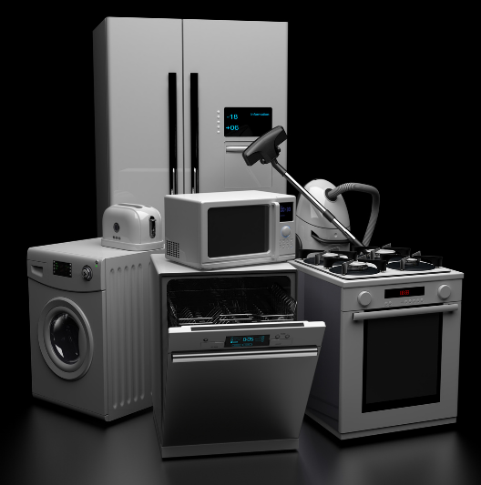
Appliances, TVs, Computers, WiFi…

Slide 43

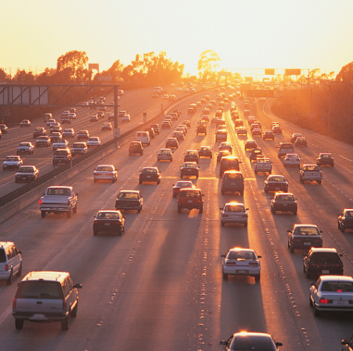
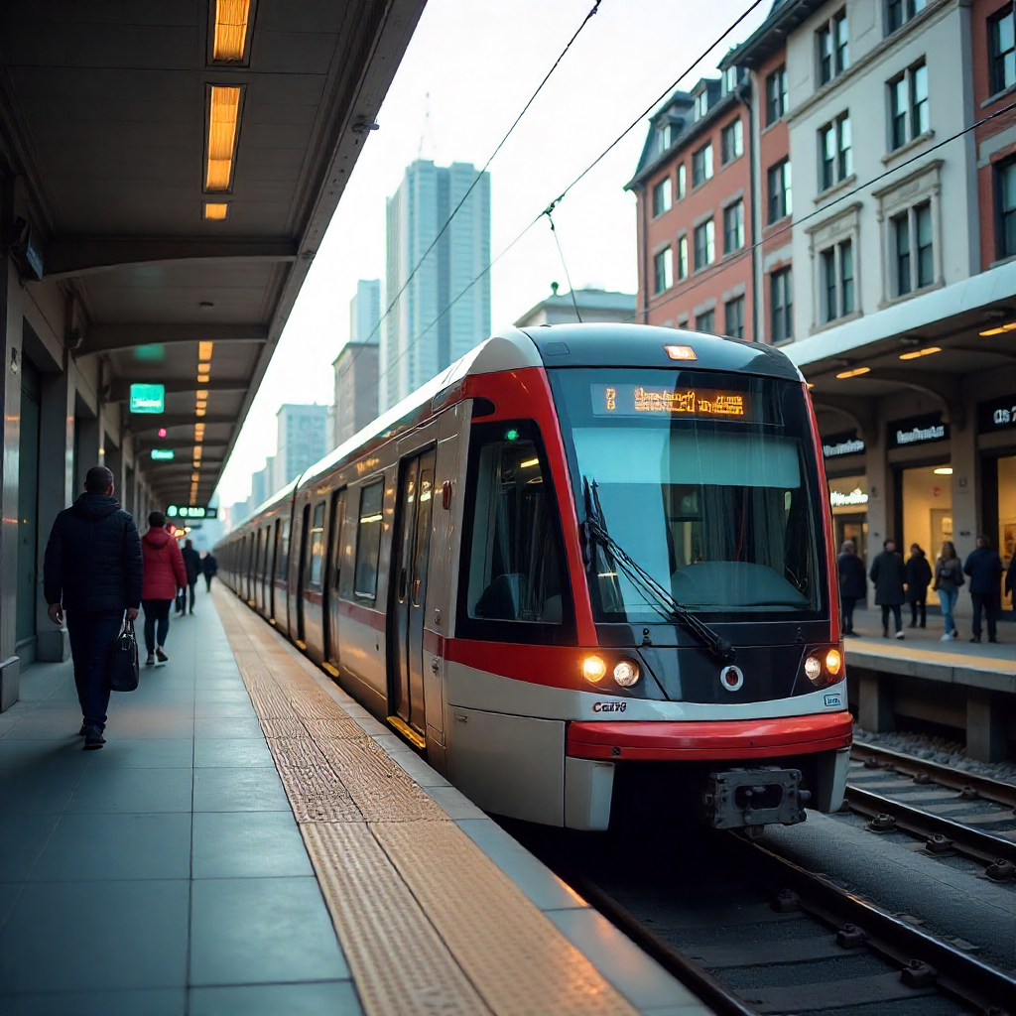
Cars, Trains, Planes
One International Flight =
a similar amount of radiation as

Slide 44
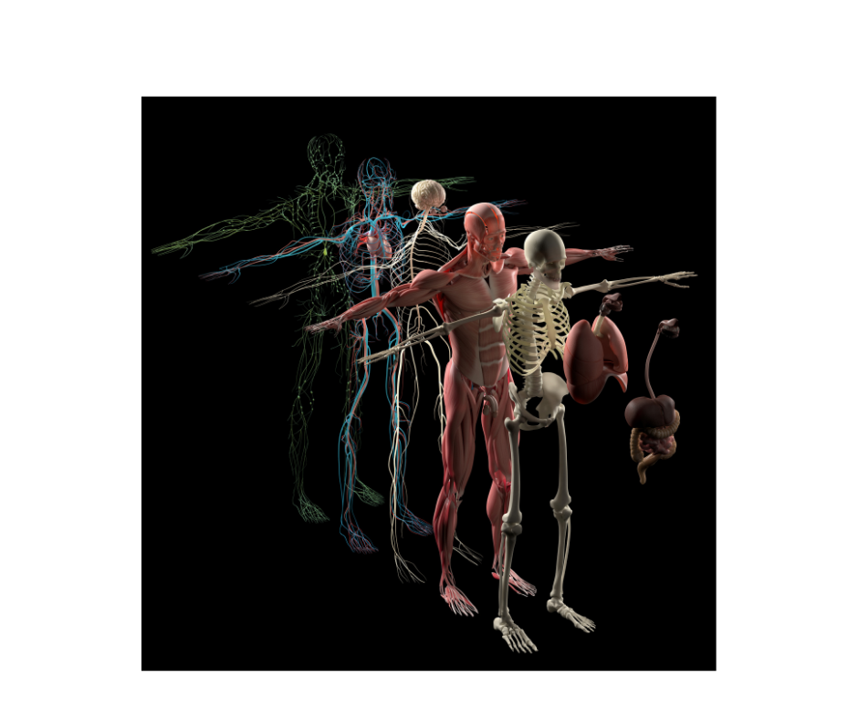
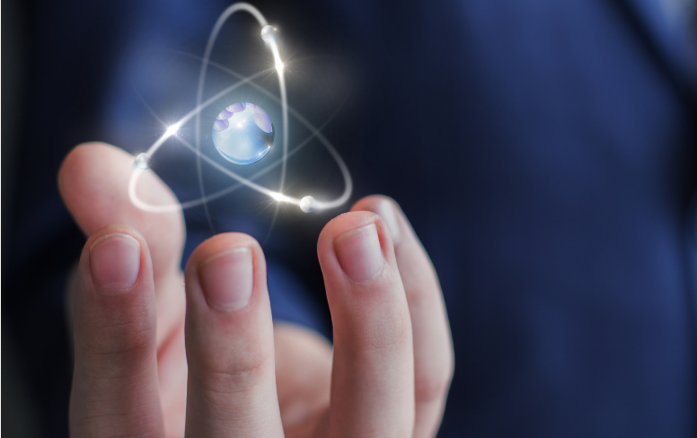
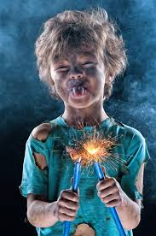
Why Are Humans Negatively Affected
by EM Frequencies & Radiation?
Because we are 90% water
& water conducts electricity!

Slide 45
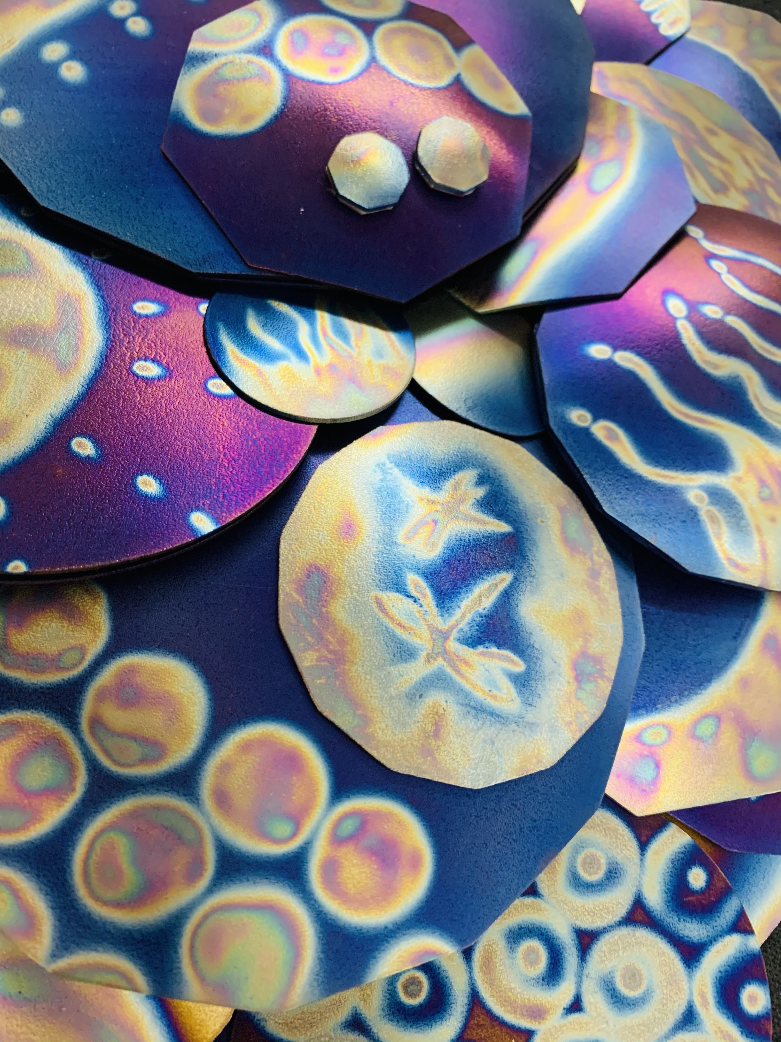
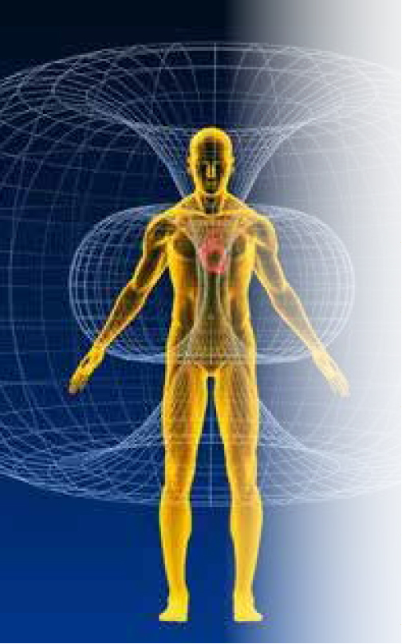
Man-made
Electromagnetic Frequencies
& Radiation penetrate our bodies
& produce chaotic patterns
at the subatomic level!

Slide 46
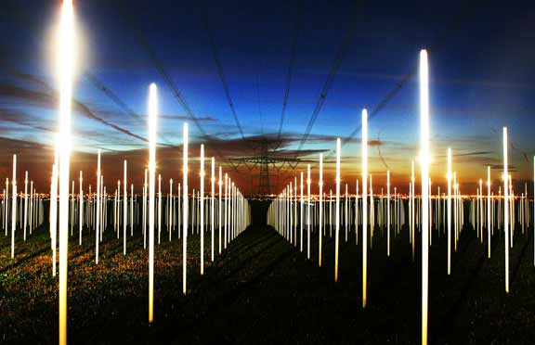
We are Electromagnetic beings of Light!
and we interconnect with each other through the electricity that emanates
from our nervous systems.
And our very conductive bodies act like antennas for all of these EM Frequencies!
Remember those photos of the two men holding up the fluorescent light bulbs?
That’s us, all the time!
We never get a break from it! And those chaotic fast moving penetrative frequencies are more than we are designed to physically handle!

Slide 47

Geopathic Stress from
EM Frequencies & Radiation,
puts stress upon our immune systems
which lowers out ability
to fight off viruses & bacteria.
It is a weak, but continuous
stress on our DNA!
And over many years,
it can seriously disrupt
our metabolism on a molecular scale.

Slide 48

The Radiation in one Mammogram
is equal to several hundred X Rays!!!

Slide 49
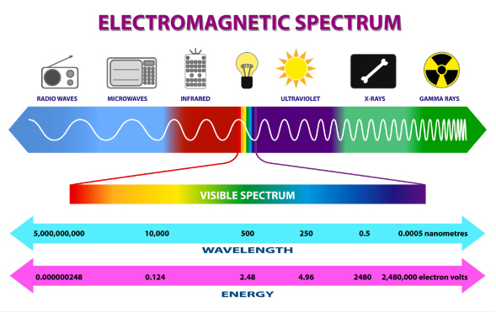

Slide 50
1 nanometer is
one billionth of a meter
Radiowaves, microwaves, etc.
have a longer wavelength ranging from 1 millimeter to 1 meter
X-rays & Gamma-rays have a much shorter wavelength and thus much higher energy than radio waves & microwaves
X-rays have a wavelength range of .01 nm to 10 nm
Gamma-rays have a wavelength range of .01 nm

Slide 51
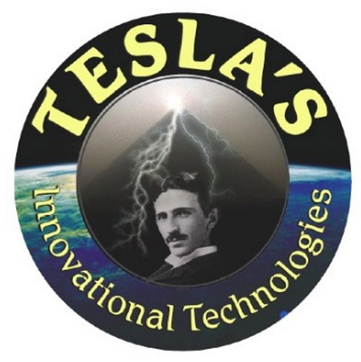
Nikola Tesla &
to the Rescue!!

Slide 52
Tesla was quoted as saying to a group of English scientists only months after the opening of the Niagara Power Station in 1895,
“The electricity I have invented will prove to be one of the most dangerous things on Earth to man and I’m looking at an alternative”

Slide 53
The Nicola Tesla Connection
After the destruction of his Free Energy Tower, because his promise of harmless free electricity had been purposely ruined,
he invented a technology to harmonize those frequencies.
Tesla began to find other innovative open-minded scientists
to pass his technologies on to.
One of those scientists was a young air force physicist,
Ralph Bergstressor, who was a former NASA physicist
who developed rocket fuel for the space program.

Slide 54
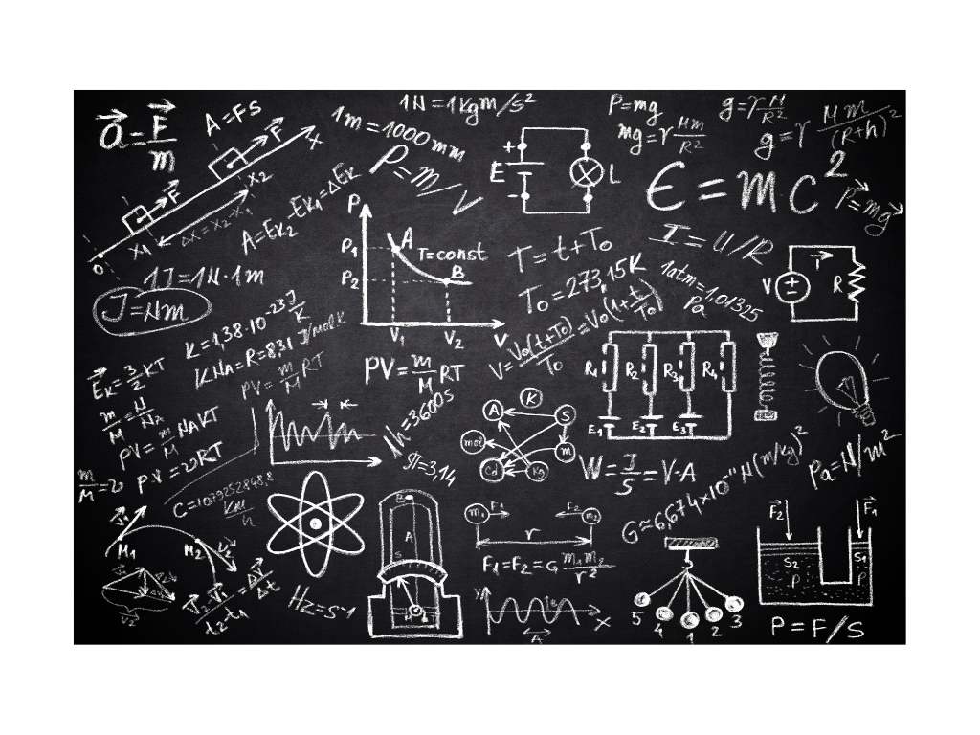
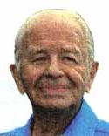

Nikola Tesla Created the Technology,
then passed it on to Ralph Bergstresser
Tesla Ralph Bergstresser

Slide 55
Ralph worked on the project given to him by Tesla
for the rest of his life,
which was to create a device that would alter the frequency of metal, allowing the metal to act as a transceiver
which would render the EMR and EMF non-harmful,
thereby alleviating the geopathic stress.
He made the first device in 1971.
In the early 1990’s, Ralph and the CEO of Tesla’s Innovational Technologies began a correspondence,
and the device was sent to Australia from Canada.

Slide 56
Ralph then passed it on to Carol,
the CEO of Tesla’s Innovational Technologies
Tesla Ralph Bergstresser Tesla’s CEO

Slide 57


Carol then employed two physicists to upgrade the device,
and that’s how Tesla's Innovational Technologies was born!
From there, they created
Countless Amazing
Harmonizing Products…

Slide 58
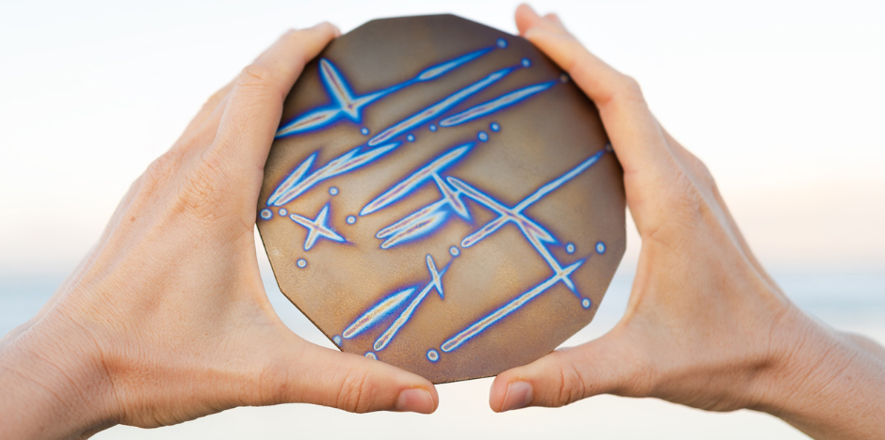
to transform your home or business
into a sanctuary of
Peace, Well-Being & Vitality!

Slide 59
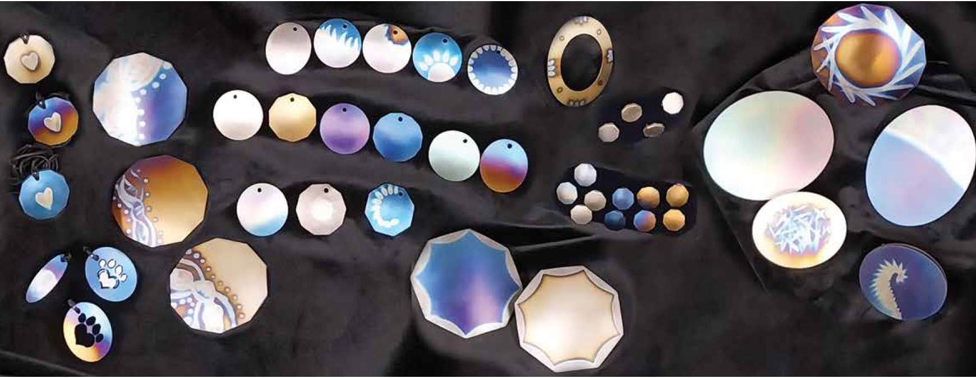
Where to Start?

Slide 60
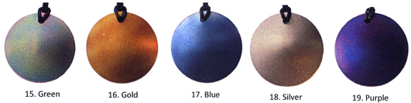
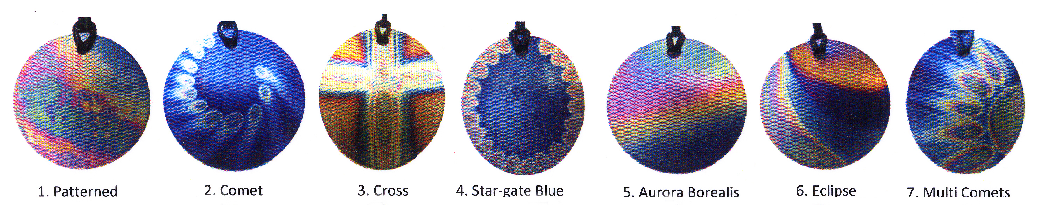
Tesla’s Personal Pendants

Slide 61
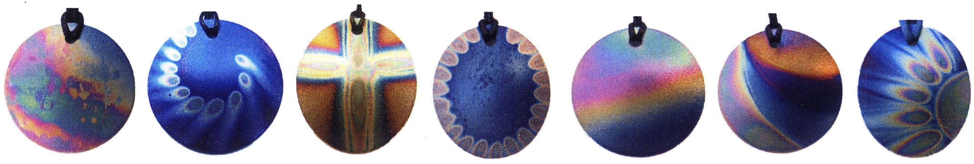
How do they work?
Tesla’s Harmonizing Pendants
Have been energized with Cosmic Frequencies,
which Transmit Life-Force Energy
to your Thymus Gland,
which Energizes your Immune System & your Auric Field.
so that you are better able to withstand the negative effects of Electro-Magnetic Frequencies & Radiation
that emanates from electricity, appliances, computers, phones,
wi-fi, radio waves, microwaves, etc.

Slide 62

Tesla’s Personal Pendants
also activate all your
brain frequencies
(alpha, beta, theta & delta)
which raises your vibration
to a higher state.

Slide 63
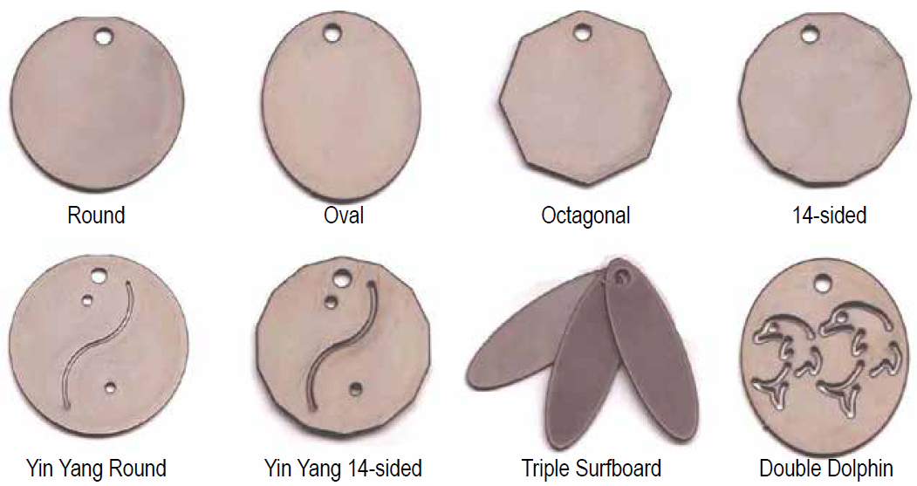
Tesla’s Personal Harmonizing Pendants
8 Different Shapes

Slide 64
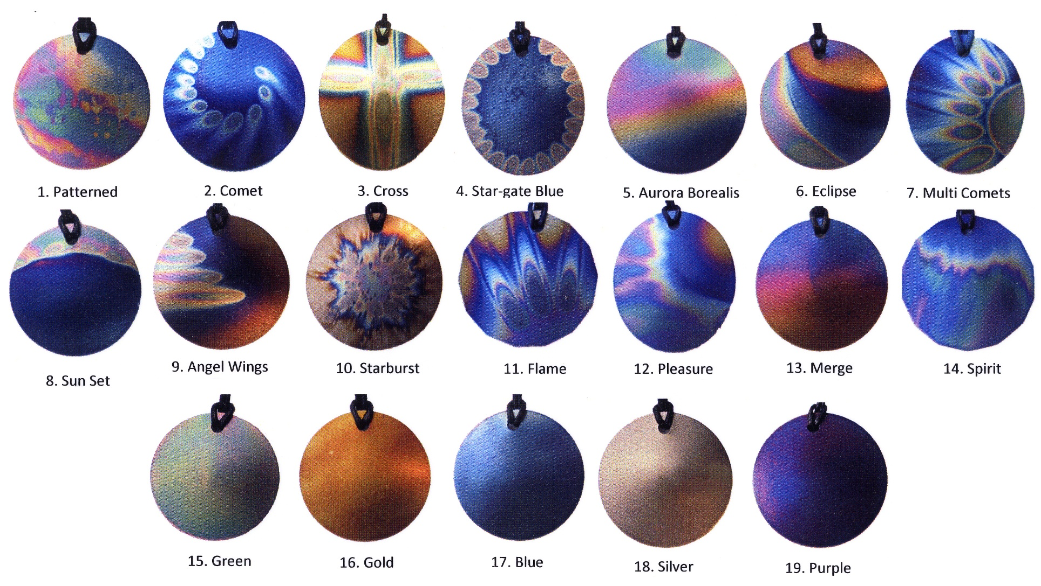
And over 33 Unique & Artistic Designs
Personally Colored By Our Amazing Artisans!

Slide 65
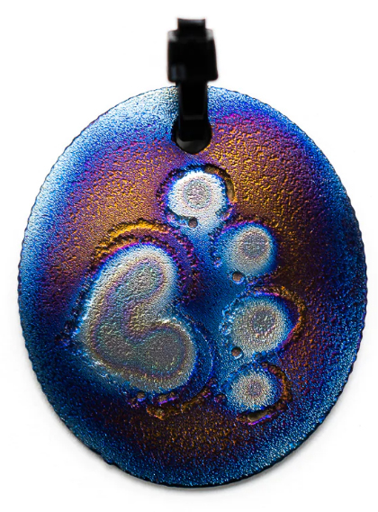
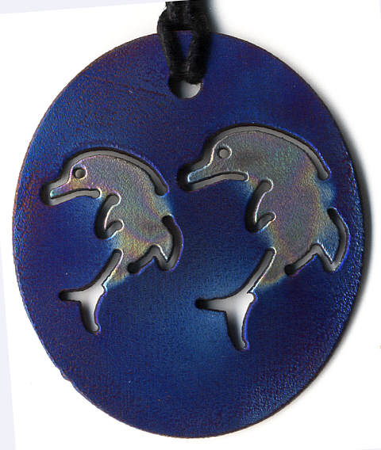
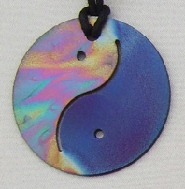
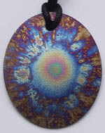
Adult, Teen, Child
& Furry Friends Pendants

Slide 66
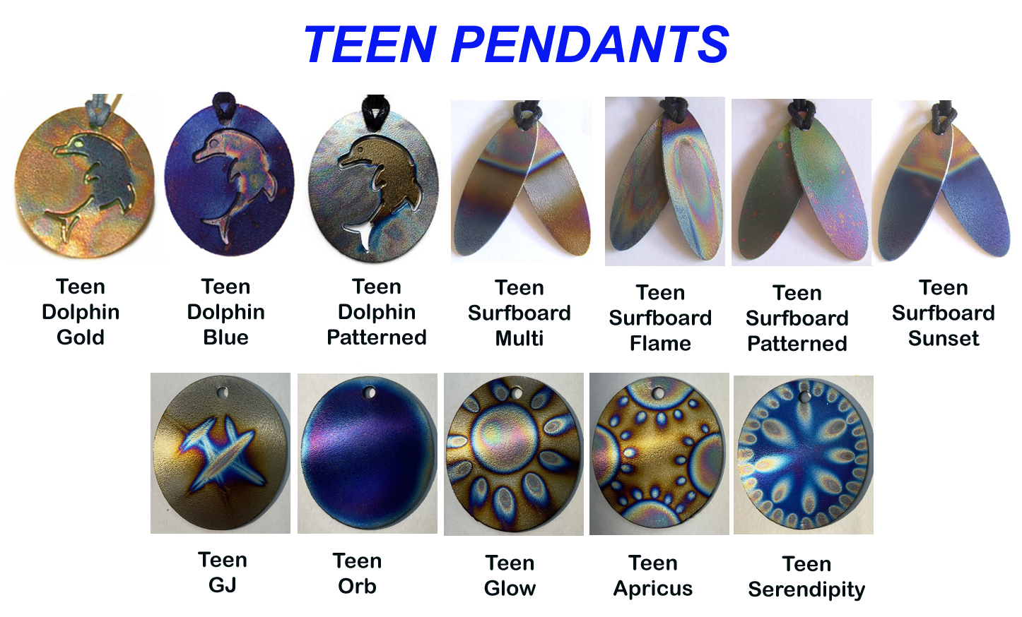

Slide 67
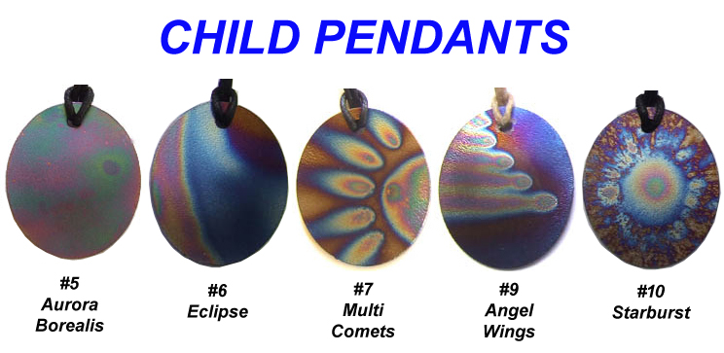

Slide 68
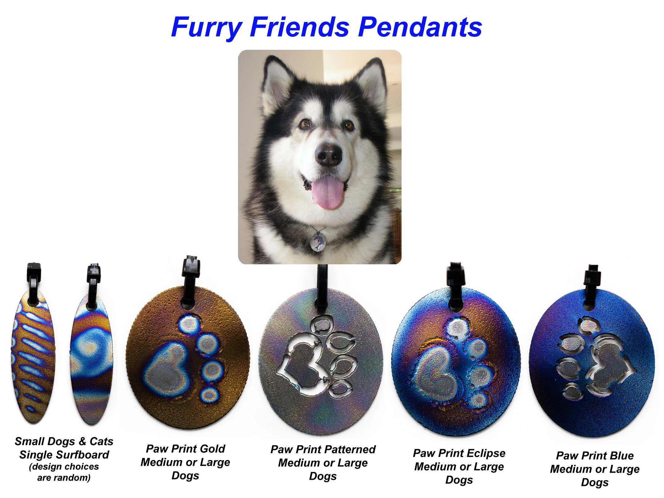

Slide 69


How to Choose Your Pendant

Slide 70
Which Shape Resonates with You?

Slide 71

Choose your Design

Slide 72

Yin Yang Style Pendants

Slide 73






Testing the Products
Kirlian photography, Aura Photography, Ryudoroku Tests…

Slide 74

Energetic Effects
Aura Photo of me
Wearing a pendant
Beautiful Golden Aura wearing my 14-sided
Yin Yang Pendant

Slide 75
KIRLIAN DIAGNOSTIC PHOTOGRAPHY
The below slide shows the results of Kirlian biofeedback testing on a random person.
You can see the difference in strength of the energy field
over just 20 minutes wearing a Tesla’s Pendant.
And then the huge difference after 28 days!
Kirlian photography measures energy around the fingers.
The fingertips are placed on a biofeedback pad.
The information about the energy flow in the body
is recorded and displayed by the computer.
This testing is used for diagnosis in many hospitals
in Eastern Europe claiming 98% accuracy.

Slide 76

KIRLIAN DIAGNOSTIC PHOTOGRAPHY

Slide 77

Phone Tags & Laptop/Tablet Tags
Harmonizing the Microwave Radiation from
Mobile Phones, Tablets & Lap-tops
+ Cell phones, Cordless phones, Smart Watches, Wireless Headphones, WiFi Routers
& other small electronic personal devices

Slide 78



Phone Tags

Slide 79


Laptop/Tablet Tags

Slide 80
Treating a mobile phone, tablet or laptop
with a Harmonizing Tag, renders it
biologically harmonious to the user & anyone nearby.
The microwave frequencies that radiate from phones,
have been extensively tested all over the world,
and the harmful effects have been shown to affect people biologically up to 9 metres (29 feet) away.

Slide 81

When mobile phones first came out,
Dr. George Carlo was employed
by one of the large telecommunications companies
in America,
to prove that mobile phones were safe for use by humans.
His findings proved the exact opposite!
And subsequently, his work was not published!
And mobile/cellular phone technology went out to the public without any warnings!
He then became a whistleblower
and published the information himself!

Slide 82

Phone Radiation Brain Effects
-
These images are MRI scans of the brains of different people holding a mobile phone up to their ears.
The first image shows the radiation penetration in the head of a child penetrating almost their entire brain! The next image is the head of a 10-year-old penetrating a little less.
While the last image shows an adult with less penetration, probably due to a stronger immune system.

Slide 83

Don’t Cook your Brain
with Microwaves!!!!

Slide 84

The Pocket Travel Plate
The pocket plate is designed to calm your bio-energetic system & harmonize 5G & other EM Frequencies & Radiation you encounter in life while you are working, playing & traveling.
It also helps alleviate the damaging effects of the Sun's radiation while flying
which alleviates jet lag.
Short Flights Only!
International Flights see the Car Plate or 5G Oyster
It is also excellent for healing purposes,
to alleviate minor pain
& to energize water & food.

Slide 85

Testing the Effects of a Pocket Plate with the
ACUTEC RYODORAKU “Neurometer” Device
Testing by a prominent Brisbane Australia naturopathic clinic

Slide 86

The Bare
Essentials Kit
Pendant,
Phone Tags &
Pocket Plate
5% discount

Slide 87

Small Octagonal
(Computer)
Plate
Harmonizing the EM Radiation from your computer, (helps with eyestrain).
As well as smart meters, gaming devices, WiFi, & other electronic devices.
It can also be used to treat water
or to assist with healing small cuts, bruises or bites, in a similar fashion to the pocket plate.

Slide 88

The 5G
Oyster Plates
building the foundation of your harmonic bubble
Harmonizing EM-Radiation from Radio/TV Wi-Fi & Geopathic Stress in your home, farm, property, business/office.

Slide 89

The Small 5G Oyster Plate
Creates a 1-acre sized harmonic bubble.
for houses & apartments.
The Large 5G Oyster Plate
Creates a 30-acre sized harmonic bubble for large farms & properties.
The 5G Oyster Plates
produce a specific non-hertzian energy which renders the frequencies from mobile phone towers, satellites, radar and high-tension powerlines biocompatible with our bodies.
We can show you where to place the plate in your home for maximum efficiency.

Slide 90

The Car Plate
Harmonizing the negative effects of
EM Frequencies
from your car, trains
& international flights
Say, “hello to calm, ease, alert driving & gentle easy flights” – with no jet lag!

Slide 91
1 international plane flight = 6 chest X-Rays
Did you know that during one international flight, when flying in the stratosphere above the earth’s protective ozone layer, your body receives a similar amount of radiation as 6 chest X-Rays?!

Slide 92

Hybrid Car Kit

Slide 93

The Electron Stabilizer
Harmonizing the Electricity, TVs, Computers & Appliances
in your Home or Office.
It is designed to treat the fields which electrically sensitive people feel when exposed to EMF.
It works in tandem with the 5G oyster to create the
Tesla’s harmonic ‘bubble’.

Slide 94


The Water Harmonizer
Negatively Ionising your Water
(that’s a positive thing)
Apartment/Travel Water Kit
House Water Kit

Slide 95

The Water Kit
The Water Kit treats both magnetic & electrical fields that have been picked up by the minerals in water
as water travels through underground pipes, under power lines, etc.
It also treats introduced toxic chemicals such as chlorine and fluoride,
that have been introduced into the water supply.
The water kit negatively ionizes and puts life-force back into the water,
which reduces surface tension and allows more oxygen to be carried in the water.
The body’s cells are then better able to absorb this water,
as does soil & plants.

Slide 96
The Water Kit
It also returns the water to a more natural state, which is evident in the improved taste and increased plant growth, when you water plants and vegetables.
The resulting soft, energised water often looks clear and has less chemical taste, resembling rainwater or a fresh mountain stream.
No filters to replace!
Water Kits last a lifetime without ever having to be replaced!

Slide 97

House Kits
20% Discount!
All the Harmonizing Products You & your Family need,
“to Create a Stress-Free, Energized & Harmonic Home!

Slide 98

Apartment Kit

Slide 99

The “Spiritual” Line
The Light Workers Kit
15% Discount!

Slide 100

The Chakra Balancer
To open & balance your clients or your chakras. Also, for blood cleansing.

Slide 101

Practitioner Plates
For Healers & their Clients,
to strengthen and harmonize the healing practitioner's energy field,
help alleviate psychic stress and create a harmonic space
to help clients enter an Alpha/Theta brain-wave state, making the Practitioner's work more effective and accelerated.

Slide 102


Eye Awakener
Designed to open your third eye, help you achieve a state of calm and focus, and assist in the improvement of your vision.

Slide 103

The Amplifier
is great for meditation & to amplify your office/business work, spiritual work, creativity, etc.
It also amplifies your connectedness to your clients.
And is excellent to amplify the energetic effects of other plates, such as the Chakra Balancer.

Slide 104

The Spirit Plate
helps you become
more open & clear,
to be able to connect to "spirit”.
And help you
think in more positive ways,
to embrace life with more vibrancy.
It also helps people cope with the spiritual and emotional turmoil
that accompanies feelings of overwhelm and helps to remove energy patterns that need to be released.

Slide 105

Hearten Soul Plates
The HearTen Soul personal,
oyster-style pendant
is worn over the body’s Assemblage Point, which is the epicentre of the human energy field,
and has a direct influence over the biological activity of all organs.
The Assemblage Point
connects our heart and soul
and regulates how we feel and behave.

Slide 106


The Heartsender & Transcender
To help you get out of your head
& feel with your heart
To help clear the mind
to access higher states of consciousness

Slide 107
to Create Your Own Harmonic Peace Bubble!
And Many Other
Amazing Products from

Slide 108

Available at
TeslaProducts.com

Slide 109
But That’s Not All!
Are You Passionate About This Subject?

Slide 110
FREE Training
How to Harmonize
the Damaging Effects of Electromagnetic Frequencies
& Radiation with
Tesla’s Harmonizing Products!

Slide 111

Support

Slide 112

With your FREE Training,
you will gain a
working understanding
about the most damaging frequencies that are negatively affecting our health,
as well as the art of dowsing,
kinesiology
and other techniques

Slide 113

to determine the ‘Geopathic Stress’ levels
in your and other people’s homes,
businesses and properties.

Slide 114

As a Registered Tesla’s Consultant
you will be granted an official license
to purchase the products at a
20% discount!
To resell Tesla’s Products online, at your shop,
healing center, markets, seminars, etc.
Cha Ching!

Slide 115

Support
With Tons of Support from Master Zoda
“Succeed & Have Fun You Will!”

Slide 116
The only financial requirement
is to own a complete Tesla's 'House Kit’

Slide 117
Which contains all the products
you & your family need
to create a stress-free & harmonic home!

Slide 118
More info, go to:
TeslaProducts.com
-
zakairan.com/Teslas/TeslaConsultant.html

Slide 119




Very Happy Customers!

Slide 120
Countless Satisfied Customers!
I have noticed a definite improvement in my eyesight
since wearing my Tesla's Pendant for about two months! - Ilona Pettendy
After trying many products, I have found that yours are without a doubt the most effective.........(Energy born of light and love always are!) THANK YOU! E
Since both my teenage sons have been wearing the energy harmonizer pendants for a month now, I thought I should let you know that my younger son Jase, who suffered almost daily headaches from EMF sensitivity, has not had one headache since!
My oldest son had frequent rhinitis which has also virtually ceased and they're both falling asleep more easily. We're all very happy with the effectiveness of the beautiful pendants, thanks very much. With best wishes - Jeannie :)
hi Zakairan, I love the energy of it - makes my heart sing.....
such a small thing has a real nice frequency. xo Saraela

Slide 121
Greetings Zakairan, I have some more news about the effects of the Tesla House plate i bought from You!
Recently a friend was in a bad car accident, she had multiple injuries, the worst was all ribs broken down one side and an almost amputated foot, her condition was not good, she had a bad infection that was making one wound very hard to heal, in fact they had to cut out a grapefruit sized infected piece of skin and muscle, down to the bone on her leg/ankle, to stop the infection that was Anti-Biotic resistant, but still things were not looking good, and there was talk of amputation !
I was inspired/guided to take my Tesla Plate with me, i put it under her wound to start, and then under her bed, not only has her condition improved quite dramatically. There is no more talk of amputation,
and her muscles are growing back quicker than expected !
so much so they are now going to do a skin graft and maybe let her go home in a few weeks! Blessings Mark SittingBear Amara

Slide 122
Want more info about…
How to Harmonize the Damaging Effects of
Electromagnetic Frequencies & Radiation
with
FREEEMFBOOK.com
by ZaKaiRan

Slide 123
Thank You Fairy Much!

Slide 124
TeslaProducts.com

